Slide 1

Marble Falls High School
Course Registration for 2024-2025

Slide 2
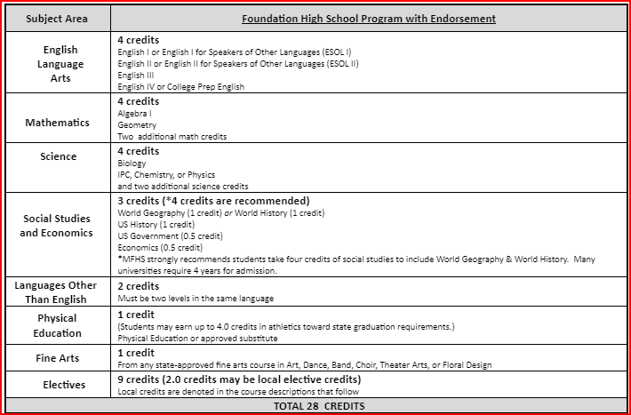
Graduation Requirements:
Red (recommneded) - Colleges may require these courses
Algebra 2
Recommend including Chem., Physics and 4th science
Recommend World Geography AND World History (all 4 credits of Social Studies)
Some colleges view 3 years of a Foreign language as a plus!

Slide 3
Advanced Courses Comparison
(courses may have a fee)
AP
On Ramps
High school credit
Universities award credit for exam score of 3 or higher at Texas schools
College Board Curriculum
2 points added to passing grades for GPA
Can be dropped at 4 weeks and semester only
High school AND college credit, with an option to decline college grade
Will receive a grade for HS AND separate college grade
UT curriculum
2 points added for GPA
Can be dropped at semester only

Slide 4
Dual-Credit
If you are interested in taking a dual credit course, you must speak with Mr. Teets to get the process started!
Mr. Teets will not be “calling you to counseling office”, you must come on your own.
There will likely be a parent meeting that is highly recommended!
You must pass the appropriate TSI test to be considered college ready for any dual credit course.
To take dual credit courses, you must register on-line for the college and complete their registration process. Signing up for the course at MFHS (in our system) does NOT sign you up for dual credit courses in their system.

Slide 5
Advanced Classes Presentation
Meeting for parents will be scheduled for the Spring!
An email will be sent out with the date and time.
Check your email!

Slide 6
Important Elective Information
Some electives have prerequisites. Prerequisites are courses that you must complete or take concurrently while you are in that class. Courses with prerequisites should not be available for you to choose in School Links.
Never select a class that you already have credit for on your transcript!
Some electives require an application.
Some courses are 2 periods in your schedule.
Consider weighted courses for GPA boosts (Honors/AP/DC or OnRamps)!
Check the MFHS/Guidance and Counseling website for applications and course information!

Slide 7
Distinguished Level of Achievement
Complete the Foundation Requirements
Complete Algebra 2
Earn an endorsement
Required for top 10% automatic admission to Texas public colleges.

Slide 8
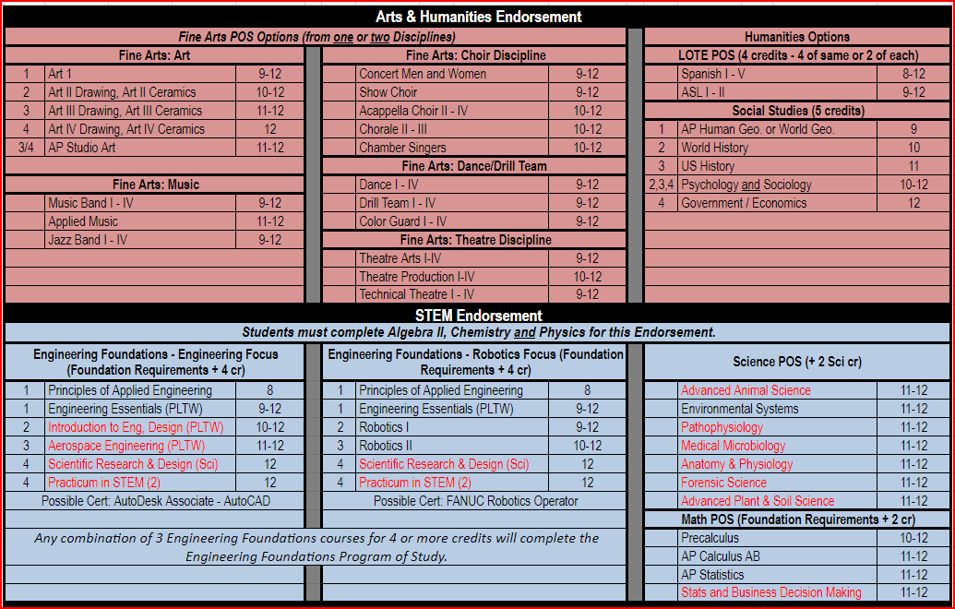
Endorsements:

Slide 9
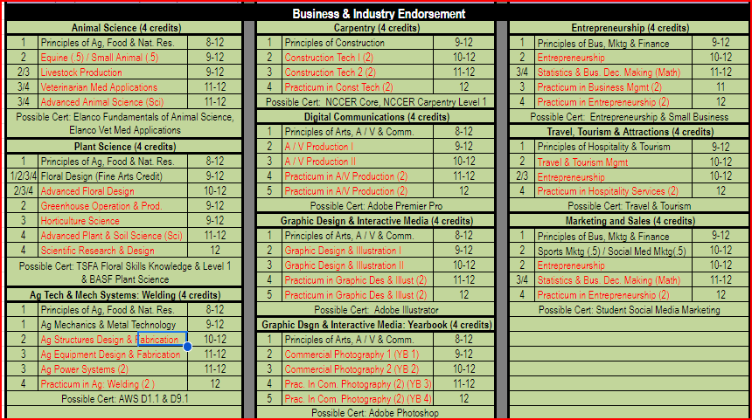
Endorsements

Slide 10
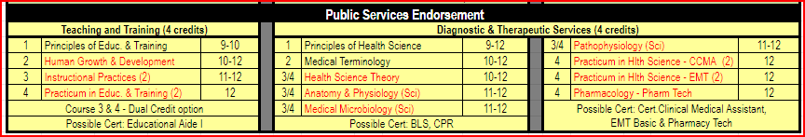
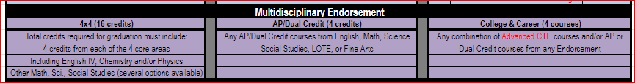
Endorsements

Slide 11
How do I make my schedule?
Review Graduation Requirements.
Review credits earned through Skyward or School Links.
Complete choices for your 4-year plan that meet all graduation requirements (this can be adjusted each year).
Go to the MFHS Counseling website and click on Scheduling tab – Use the course catalog to ensure you complete your chosen endorsement or use the School Links information to find your pathway to an endorsement. An endorsement is required to graduate.
Enter your choices in School Links! School Links course choices will complete your course requests for 12th grade. Choices 1-8 will be your requested courses. You must also choose alternates.
If you do not pick classes, including alternates, they will be selected for you and may not be able to change!

Slide 12
Check your transcript!
Counselors will do this with you individually in the hallway prior to the end of school and verify the courses you choose.
Look for required credits that you need to graduate, including credits you did not earn because of failing grades or because you owe hours.
You can complete credit for failed courses through credit recovery, long-averaging, summer school, or re-taking the course next year.
See your Assistant Principal to regain credits if you owe hours!

Slide 13


Log-in to School Links
Log-in to “Single Sign-on”.
Click on School Links. Log-in and complete the initial information.
Click on “School” link. Click on course planner.
Select continue if/when you see “Program of Study”.
Select the classes to complete your 4 year plan as we guide you through the process!

Slide 14

How to fill out your Course Requests
  Stay with me and we will fill it out together.
  Review credits needed to graduate and plan your course requests accordingly.
  Click on “Add another Course” for (English, Math, etc.) and options will come up to pick from that content area.
  You will choose courses to fill 8 academic hours and you will choose alternates.
  You can use the short cuts at the top to toggle between content areas.

Slide 15
Choose your English course for next year:
English 1 Regular or Honors | English 2 Regular Honors | English 3 Regular, UT OnRamps | English 4 Regular, Dual Credit, OnRamps or AP English 4
*Students interested in dual credit courses must fill out the required paperwork, pass the TSI and register for those classes through the college. See Mr. Teets or your counselor for more information.

Slide 16
Pick your English!
Pick your English course for next year.
If you failed a previous English course, you will be required to make that course up to graduate. You may select it here and/or see your counselor for more options.
You may be placed into a College Prep English course if you do not pass the TSI test for English. You will take this test in March of your Junior year. You can start studying now!

Slide 17
Recommended Course Sequence for Math
9th Grade
10th Grade
11th Grade
12th Grade
Algebra 1
Geometry
Math Models
Algebra 2
Algebra 1
Geometry
Regular
Honors
Algebra 2
Regular
OnRamps
Pre-Calculus
Regular or OnRamps
or
Another 4th math
Geometry Honors
Algebra 2
OnRamps
Pre-Cal.
OnRamps
AP Statistics,
AP Calculus

Slide 18
Pick your math course for next year:
Pick your math course for next year.
2. If you failed Algebra 1 or Geometry, you will be required to make that
course up to graduate. You may select it here and/or see your counselor
for more options.
3. You may be placed into a College Prep if you do not pass the TSI test
for math. You will take this test in March of your Junior year. You can
start studying now!

Slide 19
Course Sequence for Science
9th Grade
10th Grade
11th Grade
12th Grade
Biology
IPC
Chemistry
Physics or 4th Science
Biology
Chemistry
3rd Science
4th Science
Biology
Chemistry
Physics
4th Science
Biology Honors
Chemistry OnRamps
Physics, or Physics OnRamps
4th Science
*3rd and 4th year science course options are on the next slide, or in your course guide on the MFHS Counseling website.

Slide 20
3rd or 4th Year Science Options
If you failed Biology, IPC, Chemistry or Physics, you may be required to make that course up to graduate. See your counselor for options.
REGULAR COURSES
ADVANCED (weighted) COURSES
Environmental Systems
Medical Microbiology (offered every other year - even years only)
Pathophysiology (offered every other year - odd years only)
Forensics
Anatomy and Physiology
Advanced Plant & Soil Science
Engineer. design & Prob. Solving
Sci. Research & Design
Biology AP
Physics OnRamps - 1or 2
Chemistry OnRamps - 1or 2
Environmental Science AP (every other year)
Advanced Animal Science (DC)

Slide 21
Pick your Science courses:
Students must pass Biology, and either IPC, Chemistry or Physics.
Students should have 4 science credits to graduate.
If you are graduating with Multidisciplinary as your endorsement, you must take Chemistry or Physics, IPC does not apply to Multidisciplinary.

Slide 22
Course Sequence for Social Studies
9th Grade
10th Grade
11th Grade
12th Grade
World Geography
or
AP Human Geography
World History or
World History AP
US History
Reg. or OnRamps
Government and Economics
Reg., AP, OnRamps or Dual Credit

Slide 23
Pick your Social Studies courses:
Pick your Social Studies course!
Requirements: World Geography or World History, US History, Economics, and Government are required to graduate.
If you failed one of your previous Social Studies courses, you may select it here or see your counselor for more options.
World Geography AND World History are required to get the Multidisciplinary endorsement. You cannot substitute another Social Studies course (ex. Psychology or Sociology).

Slide 24
Elective requirements to graduate
You must have:
  2 credits of the same foreign language
  1 credit of fine arts
  1 credit of PE or PE Equivalent
  1 Endorsement – see endorsements in course catalog

Slide 25
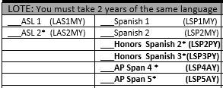
Foreign Language
Students are required to have 2 years of the same foreign language to graduate.

Slide 26
Spanish Proficiency Exam
Students who plan to register for a Spanish course and already have some knowledge and skills in the language have the opportunity to advance to the upper level Spanish courses. Marble Falls ISD offers a proficiency and placement exam to determine knowledge and skill level required for entry into an upper Spanish course. A student may place out of courses based on the outcome of the exam, which includes an objective exam, writing, and speaking sample. Credits for courses placed out of may be awarded through the exam.
A student may also receive credit for Levels 1 and 2 by taking AP Spanish IV and receiving a score of 3 or better on the AP Spanish Language exam.
The Proficiency Exam is offered several times a year. To register for the exam, please see your counselor.

Slide 27
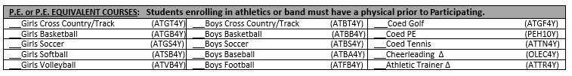
PE or PE Equivalent
1 credit required to graduate

Slide 28
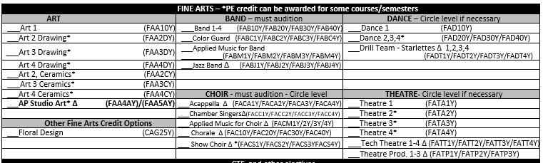
Fine Arts
1 required to graduate

Slide 29
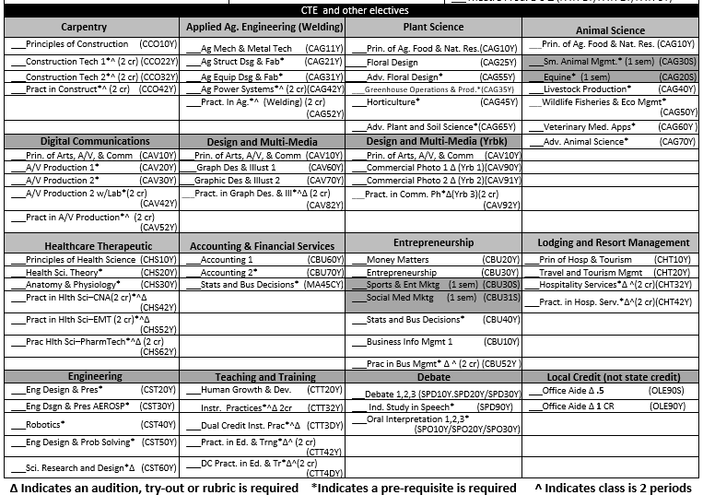
CTE and other electives
Complete your endorsement!

Slide 30
Seniors can have off-campus periods!
Fourth year Seniors who meet the requirements below may be eligible to have up to two off-periods:
Must have a minimum of 21 credits for one off period. You need to have 22 or more for 2 off-periods.
Must have shown college and career readiness by earning their CCMR “point”. See the next page fon how to earn a CCMR Point.
Must be on track to earn an endorsement and/or program of study.
Must have passed all End-of-Course exams (EOCs/STAAR tests) the student was eligible to take.
Must provide your own transportation to get on or off campus.
You cannot remain on campus during an off period(s).

Slide 31
CCMR Compliance for off-periods
Students must meet one of the following criteria to be eligible for off-periods:
  Eligible for credit in an OnRamps course or dual enrollment course
  Score of 3 or higher on any AP Test
  Earned a college credit through a Dual Credit course in ELA or Math
  SAT Score higher than 480 for Reading and Writing and 530 for Math
  ACT Composite Score of 23 or higher with at least a score of 19 on the English section and at least a score of 19 on the math section
  TSIA2 ELAR score higher than 945 and an essay score of at least 5, and Math score higher than 950 and a diagnostic level of at least 6
  Earned an Industry Based Certification through our CTE Pathways

Slide 32
Check for accuracy
Make SURE you have 8 academic hours selected. Make SURE you have alternates in the order of preference. If you do not, we will select them for you.
School Links can be used at home to show parents your choices. You can make changes yourself until your Counselor meets with you in the hallway. After your Counselor confirms your classes, you must contact your counselor to request any additional changes.
The last day to submit ANY changes to your requests will be the last day of this school year (May 23).

Slide 33
PSAT/SAT
PSAT scores:
School email
  search 10/18 or College Board
College Board account
Big Future App
  After testing, texted a link to download the app
SAT School day:
April 16th
You can study now! How can I prepare?

Slide 34

Google - Bluebook Practice Test
Click on “Digital SAT Practice in Bluebook - SAT Suite of Assessments” link
College Board has four, full-length digital practice exams
  PDF versions available for those taking paper tests - we are digital
Chromebook -- Bluebook app
Take any or all of the practice tests
The results “link” to Khan Academy for more practice

Slide 35


Questions?

